Slide 1
Assignment 4
Group 6

Slide 2
moveSort

Slide 3
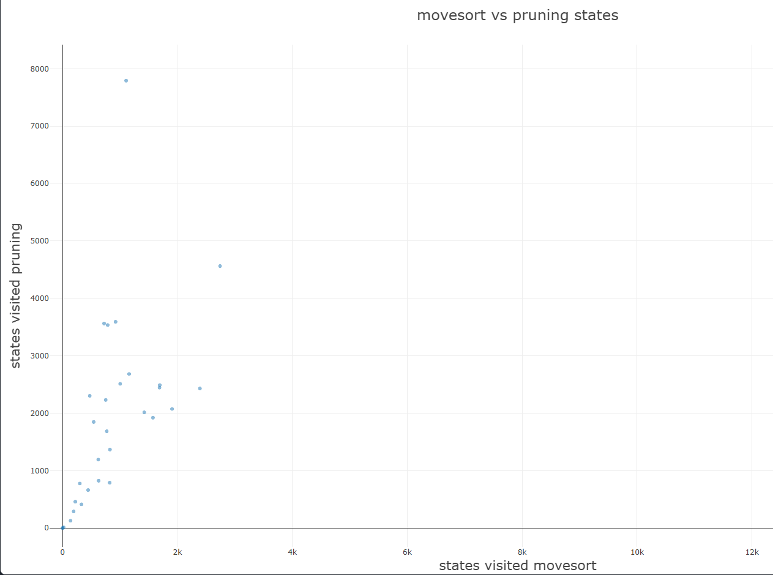

Amount of states visited decreases comprehensibly
→ Theoretically more efficient
1

Slide 4
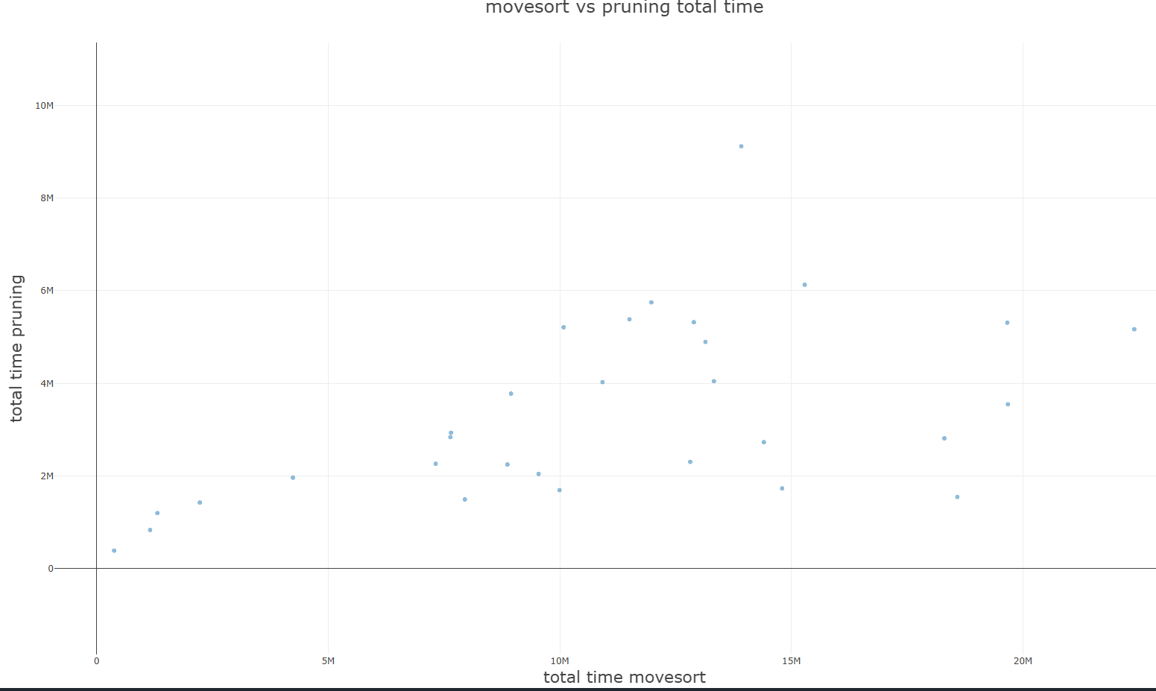

goal
Significantly more time needed for moves
→Overhead is far too expensive
2

Slide 5
Solution A
Streamline move sorting

Slide 6
Solution B

Slide 7
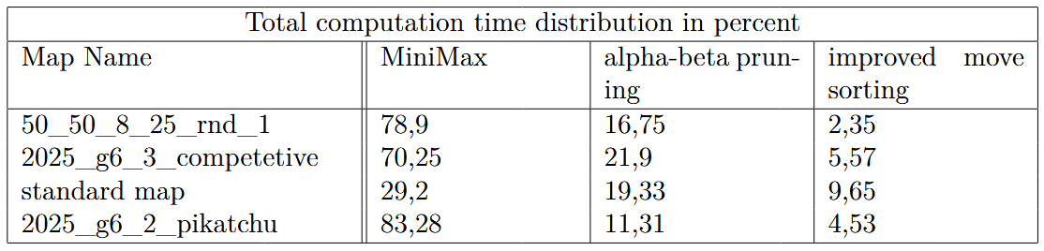
The moveSortZwei function
Benefits of MiniMaxVier (Heuristics evaluating moves in positions)
Implements move sorting with alpha-beta pruning
CornerSideHeuristic possible
3

Slide 8
Time distribution in moveSortZwei
moveSortHelper
97,8%
moveSortLeaves
13%
23,8%
59,6%
cornerSideHeuristic
minCornerSide
executeIfPossible
22,7%
18,1%
27,5%
tileWalkLoss
duplicate
swapStones
7,9%
isWalkable
4

Slide 9
Time distribution in moveSortZwei
moveSortHelper
97,8%
Calculated twice!
moveSortLeaves
13%
23,8%
59,6%
cornerSideHeuristic
minCornerSide
executeIfPossible
22,7%
18,1%
27,5%
tileWalkLoss
duplicate
swapStones
7,9%
isWalkable
5

Slide 10
Time distribution in moveSortZwei
moveSortHelper
97,8%
Calculated twice
moveSortLeaves
Only inversion/choice tiles
13%
23,8%
59,6%
cornerSideHeuristic
minCornerSide
executeIfPossible
22,7%
18,1%
27,5%
tileWalkLoss
duplicate
swapStones
7,9%
isWalkable
6

Slide 11
Performance Evaluation
Using the Measurement System implemented earlier

Slide 12
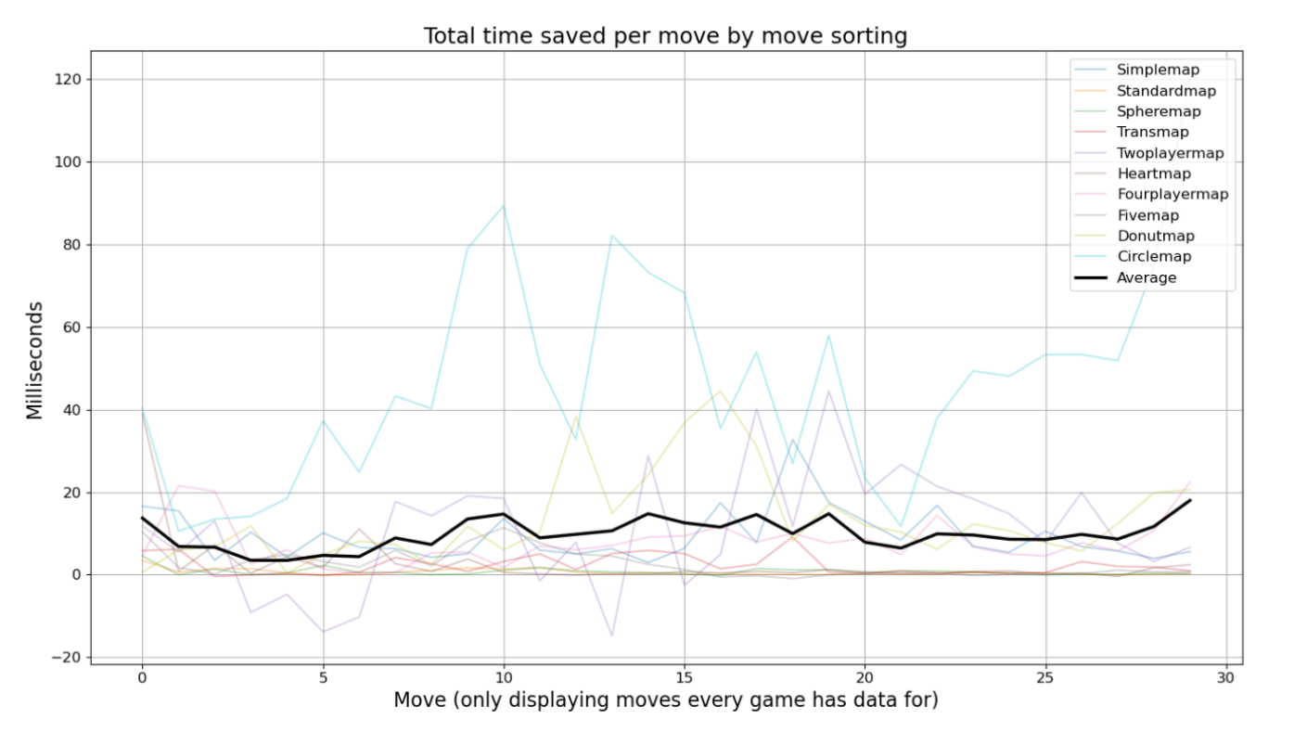
Performance Improvements
Large Maps yield a higher performance increase
7

Slide 13
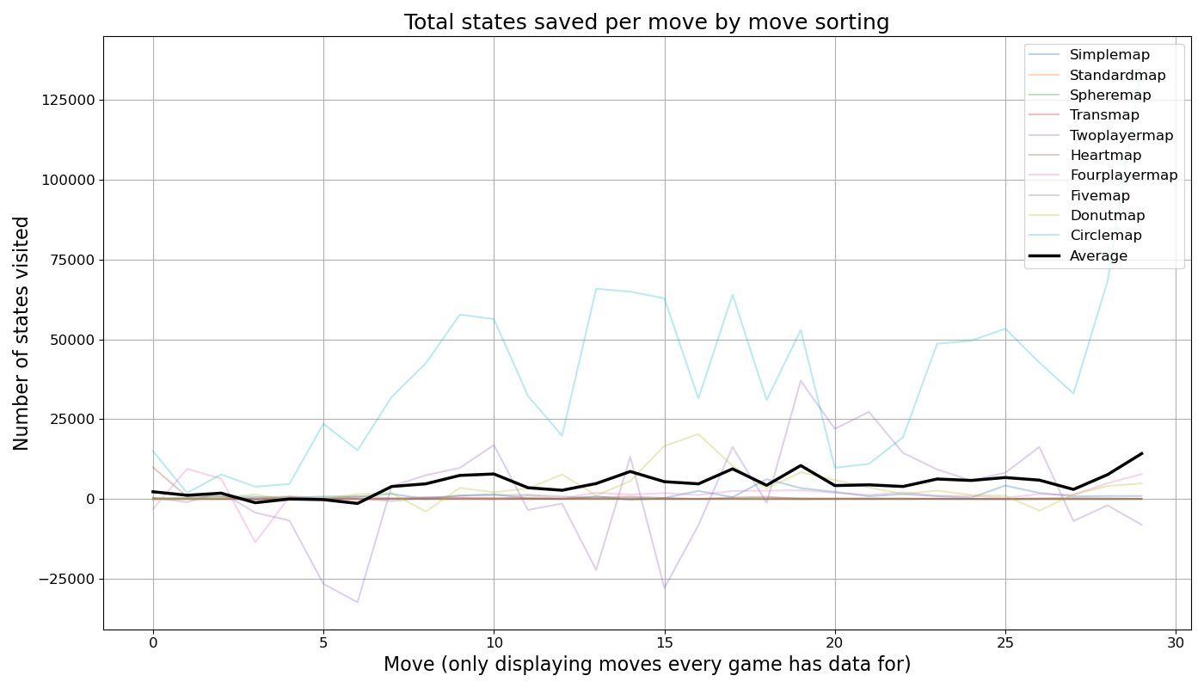
Number of states saved
Explains the performance gain based on map size
8

Slide 14
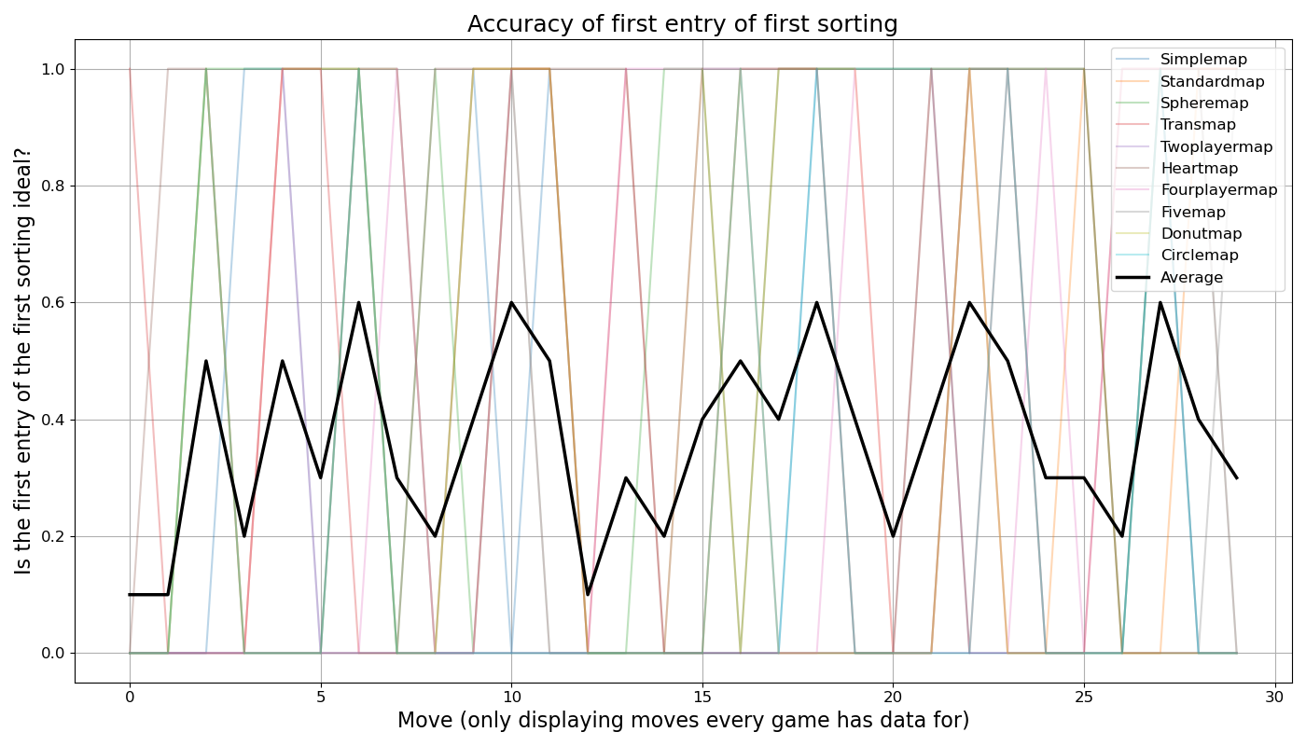
Move sorting accuracy
36.7% probability over all maps
9

